Slide 1
Program Security
Vulnerabilities / Security threats can also be caused by flaws/errors present in design, logic and programs.
The focus is on the program flaws and their consequences.
No technologies / tools are available to eliminate/address all program security flaws
R.Saravanan Sr.Prof of IT VIT

Slide 2
Types of Program flaws
Program flaws can be categorised as:
  Inadvertent flaws
    These are due to unintentional human errors.
  Intentionally induced flaws
R.Saravanan Sr.Prof of IT VIT

Slide 3
Classification of Inadvertent flaws
Validation error (incomplete or inconsistent)
Domain error
Serialization and aliasing
Inadequate identification and authentication
Boundary condition violation
Other exploitable logic errors
R.Saravanan Sr.Prof of IT VIT

Slide 4
Classification of Intentional flaws
Malicious
Non-malicious
R.Saravanan Sr.Prof of IT VIT

Slide 5
Non-malicious program errors
Many of the non-malicious program errors (unintentionally caused by mistakes of programmers and other developers) do not create serious security threats but the following errors lead to security breaches
  Buffer overflow errors
  Incomplete mediation errors
  Time of check to time of use errors
R.Saravanan Sr.Prof of IT VIT

Slide 6
Buffer overflow errors
  Data stored in the buffer of a variable exceeds capacity of the buffer. The data that has overflowed buffer is stored in the memory of
    User data / user program / system data / system program
  This causes serious malfunctioning of programs and thus leads to security violations
  Theses flaws will be exploited by attackers to create security threats.
R.Saravanan Sr.Prof of IT VIT

Slide 7
Incomplete mediation errors
  Incomplete verification of all accesses to an object to check whether they are allowed to access it or not.
  Improper validation of data
Time of check to time of use errors – known as serialization or synchronization flaw
  Eg., If a file currently used is modified after validation but before access; then we are reading invalid data from the file.
  It exploits the delay between the time of check & time of use.
R.Saravanan Sr.Prof of IT VIT

Slide 8
Malicious program - security threats
Refer PPT on malicious programs
R.Saravanan Sr.Prof of IT VIT

Slide 9
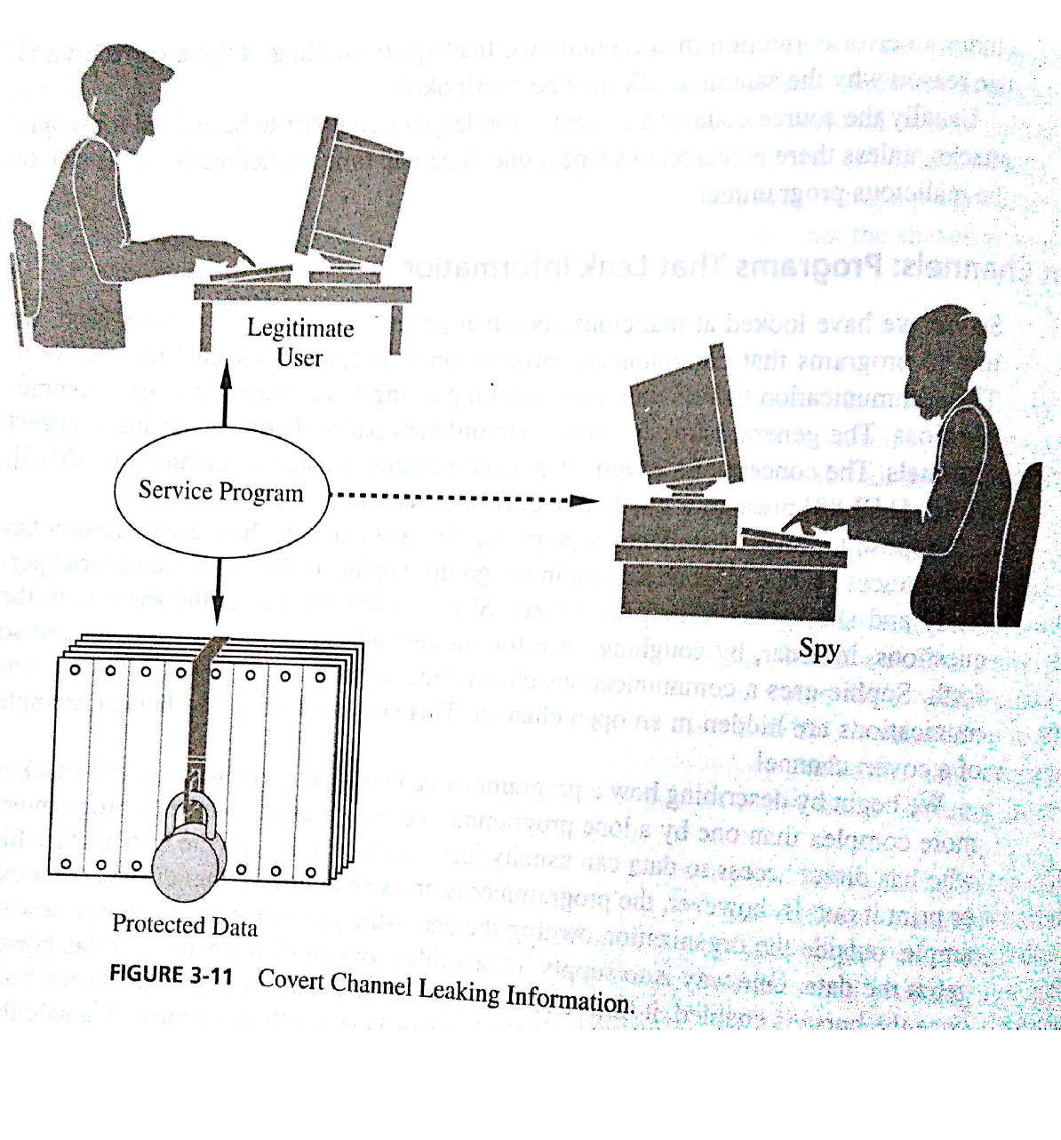
Covert Channel
(secret communication channel)
Service program infected by Trojan horse passes protected data to spy
R.Saravanan Sr.Prof of IT VIT

Slide 10
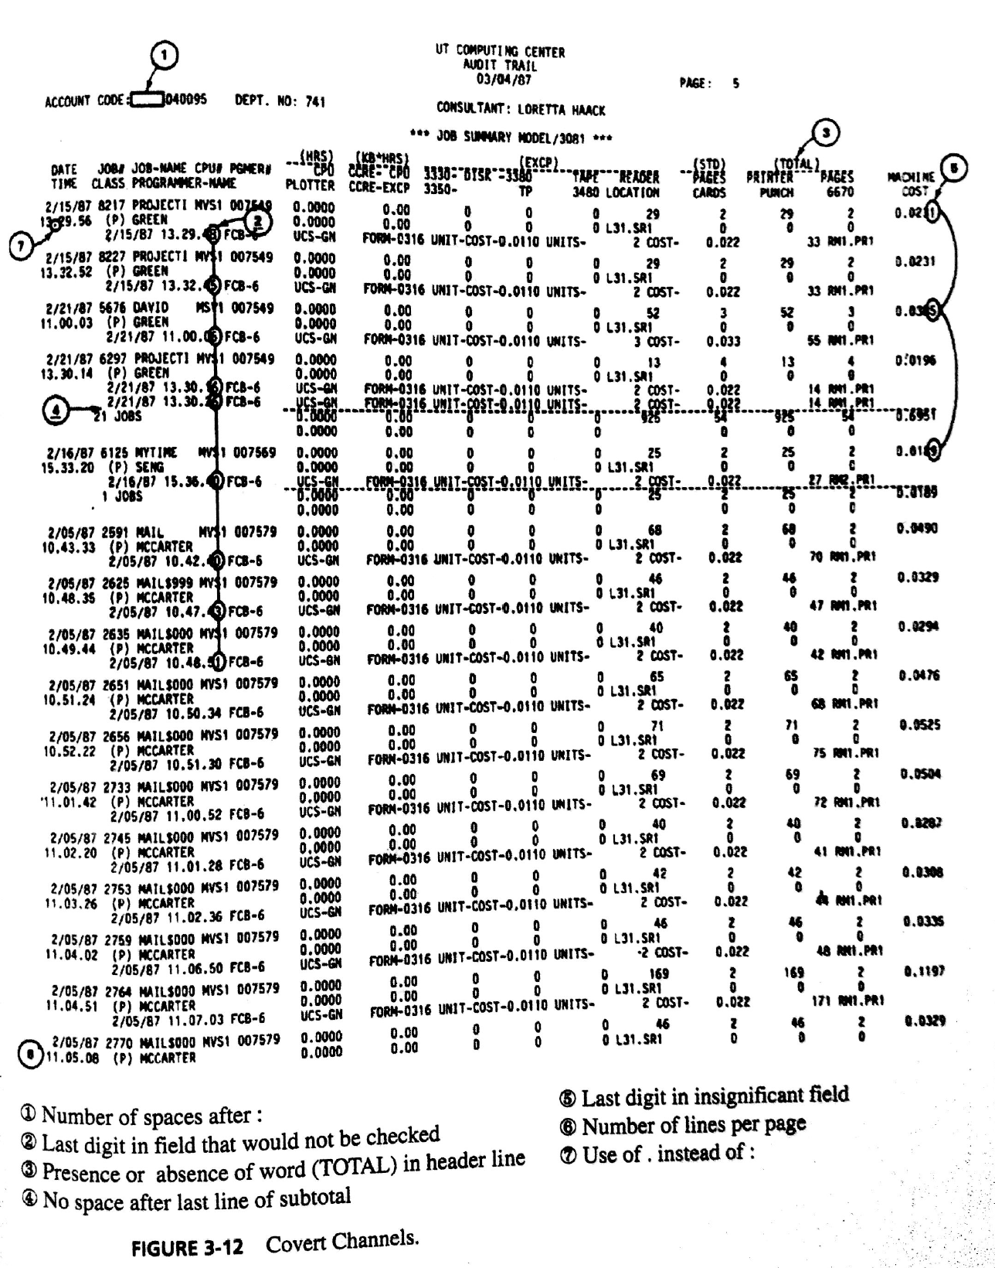

R.Saravanan Sr.Prof of IT VIT

Slide 11
Covert Channel
Covert channel is a path of communication but not designed to be used for communication
In the following example, file system is used as a (storage) covert channel
November 1, 2004
Introduction to Computer Security
©2004 Matt Bishop
Slide #16-<number>

Slide 12
Example:
Assume that Processes p, q are not allowed to communicate with each other.
  But they share a file system!
Communication protocol:
  p sends a bit by creating a file called 0 or 1, then a second file called send
    p waits until send is deleted before repeating to send another bit
  q waits until file send exists, then looks for file 0 or 1; whichever exists is the bit
    q then deletes files: 0, 1, & send and then waits until send is recreated before repeating to read another bit
P: creates Files
0/1, send
Q: signals read completion by deleting both files
November 1, 2004
Introduction to Computer Security
©2004 Matt Bishop
Slide #16-<number>

Slide 13
Covert Channels
Covert Channels use shared resources as a communication path
Covert storage channel uses attribute of shared resource.
  In the preceding example, file name is the attribute used
  They also pass information by presence / absence of objects in storage space
Covert timing channel uses temporal or ordering relationship among accesses to a shared resource
November 1, 2004
Introduction to Computer Security
©2004 Matt Bishop
Slide #16-<number>

Slide 14
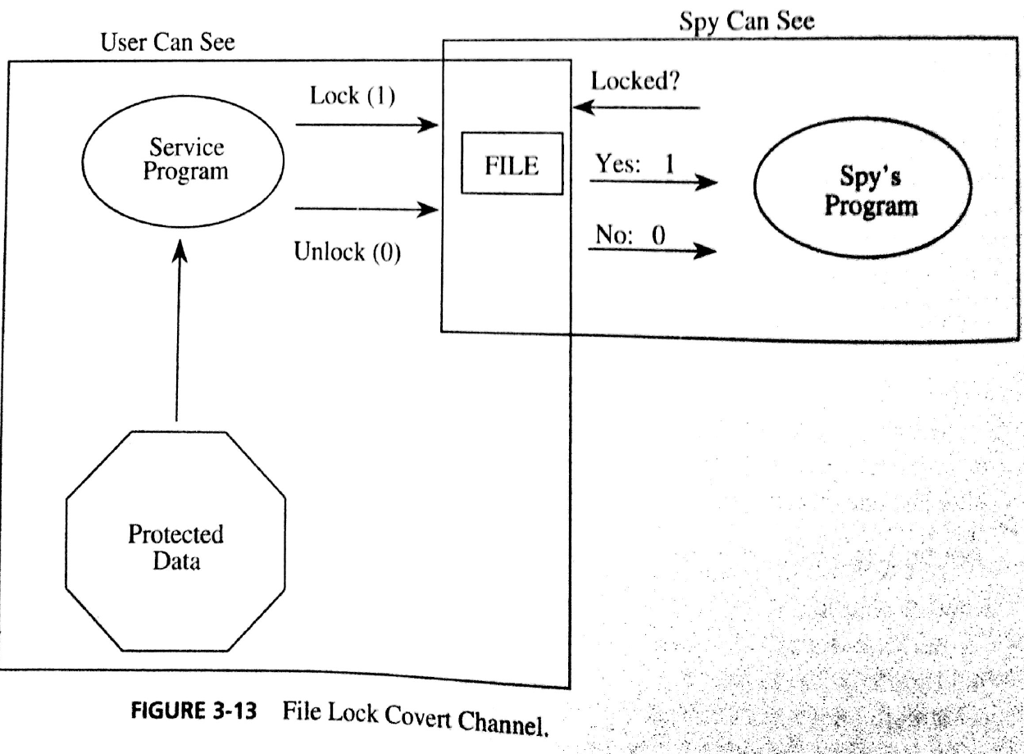
Service program locks/unlocks a file to convey 1 / 0 to spy program
R.Saravanan Sr.Prof of IT VIT

Slide 15
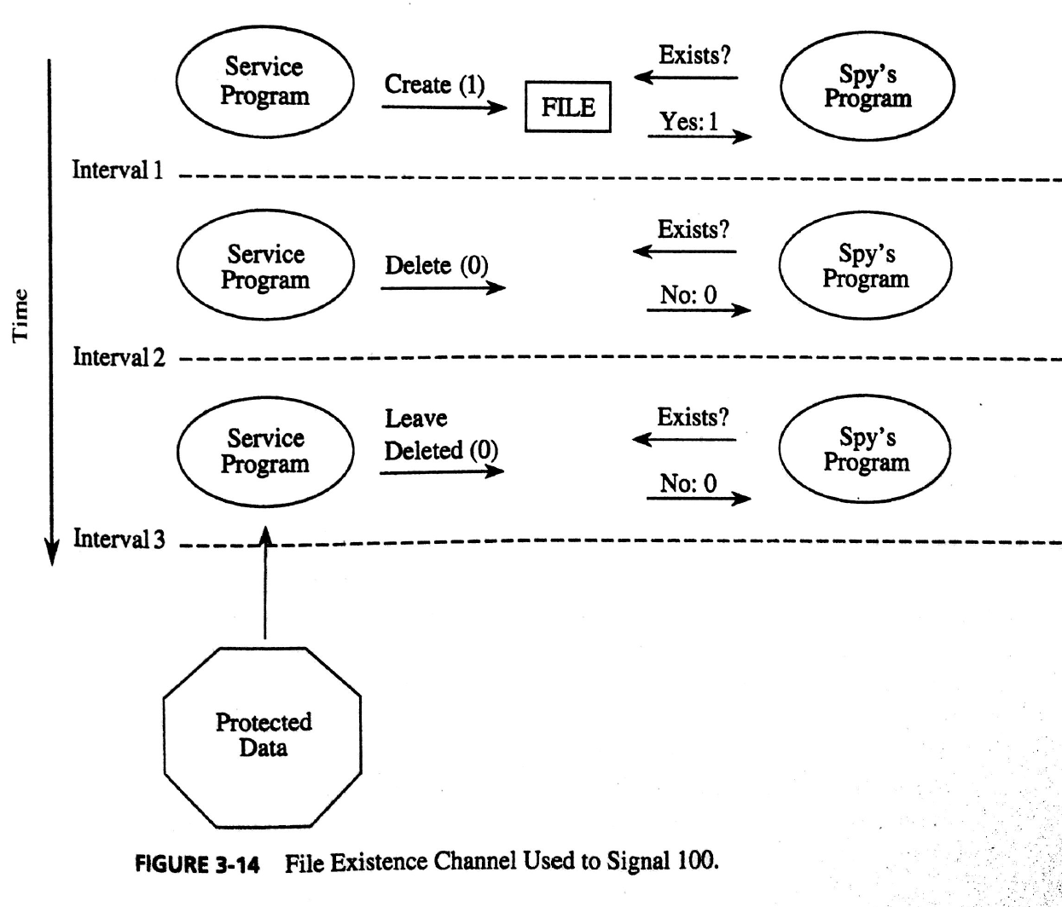
Service program creates/deletes a particular file to convey 1/0 to spy program.
Presence/absence of a file conveys bit: 1/0
R.Saravanan Sr.Prof of IT VIT

Slide 16
Example: File Manipulation
Communications protocol:
  p sends a bit by creating a file called 0 or 1, then a second file called send
    p waits until send is deleted before repeating to send another bit
  q waits until file send exists, then looks for file 0 or 1; whichever exists is the bit
    q then deletes 0, 1, and send and waits until send is recreated before repeating to read another bit
Covert storage channel: resource is directory, names of files in directory
November 1, 2004
Introduction to Computer Security
©2004 Matt Bishop
Slide #16-<number>

Slide 17
Example: Real-Time Clock
Using CPU for full quantum or releasing CPU immediately conveys 1 or 0
KVM/370 had covert timing channel
  VM1 wants to send 1 bit to VM2
  To send 0 bit: VM1 relinquishes CPU as soon as it gets CPU
  To send 1 bit: VM1 uses CPU for full quantum
  VM2 determines which bit is sent by seeing how quickly it gets CPU
  Shared resource is CPU timing because real-time clock used to measure intervals between accesses
November 1, 2004
Introduction to Computer Security
©2004 Matt Bishop
Slide #16-<number>

Slide 18
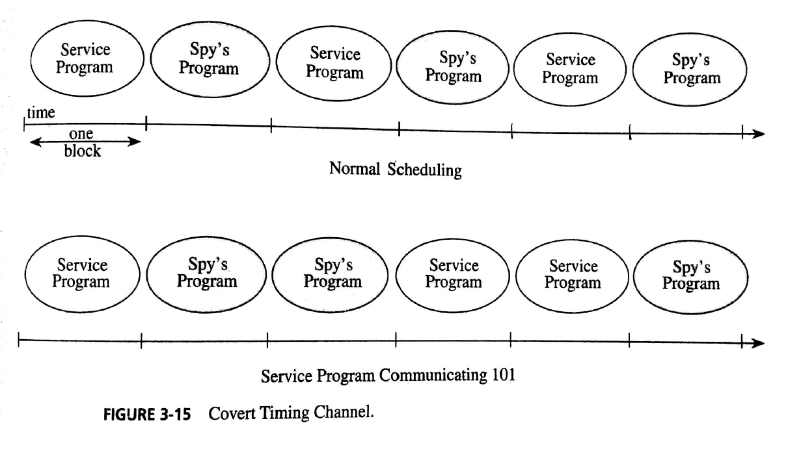
Using CPU for full quantum or releasing CPU immediately conveys 1 or 0
R.Saravanan Sr.Prof of IT VIT

Slide 19
Example: Ordering of Events
  Two VMs (One is High, one is Low)
  Share cylinders 100–200 on a disk
  A Process on High VM wants to send to a process on Low VM
Disk scheduler uses SCAN algorithm
Low process seeks to cylinder 150 and relinquishes CPU
  Now we know where the disk head is
November 1, 2004
Introduction to Computer Security
©2004 Matt Bishop
Slide #16-<number>

Slide 20
Example (con’t)
High wants to send a bit
  To send 1 bit, High seeks to cylinder 140 and relinquish CPU
  To send 0 bit, High seeks to cylinder 160 and relinquish CPU
Low issues requests for tracks 139 and 161
  Seek to 139 first indicates a 1 bit
  Seek to 161 first indicates a 0 bit
Covert timing channel: uses ordering relationship among accesses to transmit information
November 1, 2004
Introduction to Computer Security
©2004 Matt Bishop
Slide #16-<number>

Slide 21
Types of Covert Channel: Noiseless / Noisy
Noiseless covert channel uses shared resource available to sender, receiver only
Noisy covert channel uses shared resource available to sender, receiver, and others
  Need to minimize interference enough so that message can be read in spite of others’ use of channel
November 1, 2004
Introduction to Computer Security
©2004 Matt Bishop
Slide #16-<number>

